Slide 1
Emerging/evolving technology landscape and their implications on digital economy

Slide 2
Emerging/evolving technology landscape and their implications on
digital economy
Emerging economies are experimenting with new technologies and shaping the regulatory landscape, but digital access is still highly unequal.
Large-scale investment in infrastructure and innovation is crucial for building an inclusive digital future.
COVID-19 has highlighted the need for international collaboration and a joint approach to global challenges, tapping the power of the Fourth Industrial Revolution.
Boosting digital infrastructure
Digital tools for education and reskilling
Pushing for privacy
An inclusive digital future

Slide 3
Concepts of business/competitive intelligence and business analytics
Competitive intelligence is the act of understanding a company's industry and industry rivals so the company can make better business decisions,
while business intelligence refers to the tools, software, and systems that play a vital role in the strategic planning process of a company.

Slide 4
Concepts of business/competitive intelligence and business analytics
Business Intelligence
Business intelligence is, largely, analysis of an organization’s internal data. It involves collecting large amounts of raw data regarding all aspects of the business, from productivity to profits and losses, and transforming it into actionable insights. Companies use business intelligence as a means to identify and develop new business opportunities, and make improvements to existing processes, products, and services.
One of the major benefits of business intelligence is that it allows companies to view both historical and current data in context, which allows them to make better predictions. It’s also vital to effective measurement; businesses that use performance metrics or benchmarks as gauges for progress toward business goals rely heavily on business intelligence. Business intelligence has applications across all levels of an organization, from product development and pricing to staffing, strategic planning, and process improvement.
The term business intelligence is often used interchangeably with business analytics. Some make a stronger description between the two, defining business analytics as the use of quantitative and statistical tools, while intelligence focuses more on qualitative analysis, such as asking questions and interpreting reports. However, most argue that business analytics is a key function of business intelligence, and that true BI cannot be achieved without analytics.

Slide 5
Concepts of business/competitive intelligence and business analytics
Competitive Intelligence
While business intelligence focuses on a company’s internal data, competitive intelligence focuses on the external factors that influence the operation. Competitive intelligence means looking at the state of the market in which a company operates, to identify trends, potential threats, and points of differentiation.
Often, competitive intelligence includes looking closely at a company’s competitors, and looking for their strengths and weakness to identify potential opportunities. It involves taking the information that’s been collected and turning it into actionable insights to gain competitive advantage; for example, analyzing a competitor’s poor performance in a particular market can provide a blueprint of what not to do, and some ideas of how to penetrate that market more successfully. CI practitioners are quick to point out that in order for data to be considered true competitive intelligence, it must be actionable. Simply having knowledge of your market is not competitive intelligence; having knowledge that you can use to improve your business’s position is.
It’s also important to make a distinction between competitive intelligence and corporate or competitive espionage. Competitive intelligence is gathered using publicly available information, and is completely legal. Corporate espionage, or gathering information about competitors via questionable means (such as posing as a potential customer, hacking, or poaching employees) is not only unethical, but illegal in many cases.

Slide 6
Concepts of business/competitive intelligence and business analytics
Business analytics
Business analytics (BA) is a set of disciplines and technologies for solving business problems using data analysis, statistical models and other quantitative methods. It involves an iterative, methodical exploration of an organization's data, with an emphasis on statistical analysis, to drive decision-making.
Determine the business goal of the analysis.
Select an analysis methodology.
Get business data to support the analysis, often from various systems and sources.
Cleanse and integrate data into a single repository, such as a data warehouse or data mart.

Slide 7
Social Media
“Social media analytics (SMA) refers to the approach of collecting data from social media sites and blogs and evaluating that data to make business decisions. This process goes beyond the usual monitoring or a basic analysis of retweets or ‘likes’ to develop an in-depth idea of the social consumer.”
Powerful network visualizations to discover emerging trends, topics and patterns in data
Scatterplot, bar graph, histograph and timeline views
Optimized clustering for short text with auto-naming and summaries of clusters
Document and aspect level sentiments
People, company and location entity feedback
Social engagement counts
Author and demographic information
Extensive filter and tagging capabilities
Color-by options for customized data visualization
Customizable x/y axis parameters for extensive graphing insights

Slide 8
mobile and cloud computing
Mobile cloud computing uses cloud computing to deliver applications to mobile devices. These mobile apps can be deployed remotely using speed and flexibility and development tools. Mobile cloud applications can be built or revised quickly using cloud services. They can be delivered to many different devices with different operating systems, computing tasks, and data storage. Thus, users can access applications that could not otherwise be supported.
Key features
Facilitates the quick development, Shared resources of mobile apps.
Supports a variety of development approaches and devices.
mproves reliability with information backed up and stored in the cloud.
Applications use fewer device resources because they are cloud-supported.
Mobile devices are connected to services delivered on an API architecture.

Slide 9
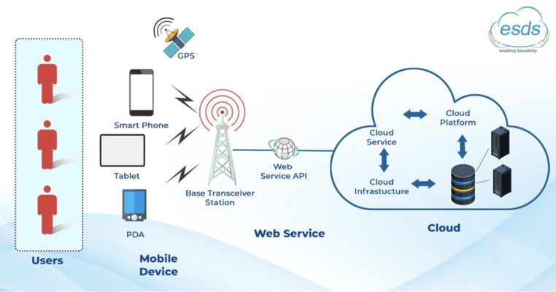

Slide 11
Data mining and Big Data Analytics
What Is Data Mining?
Data mining is a collection of technologies, processes and analytical approaches brought together to discover insights in business data that can be used to make better decisions. It combines statistics, artificial intelligence and machine learning to find patterns, relationships and anomalies in large data sets.
With data mining, a business can discover patterns in current customer behaviors that may not be apparent to a human analyst. It also can predict future trends. For example, applied to a new dataset of prospects, a model based on current customers could predict which prospects are most likely to become future customers.

Slide 12
Data mining and Big Data Analytics
How Data Mining Works
Start with historical data
Let’s say a company wants to know the best customer prospects in a new marketing database. It starts by examining its own customers.
Analyze the historical data
Software scans the collected data using a combination of algorithms from statistics, artificial intelligence and machine learning, looking for patterns and relationships in the data.
Write rules
Once the patterns and relationships are uncovered, the software expresses them as rules. A rule might be that most customers ages 51 to 65 shop twice a week and fill their baskets with fresh foods, while customers ages 21 to 50 tend to shop once a week and buy more packaged food.
Apply the rules
Here, the data mining model is applied to a new marketing database. If the company is a packaged food provider, it will be looking for 21- to 50-year-olds.

Slide 13
Data mining and Big Data Analytics
Key Data Mining Concepts
As in many fields, data mining uses its own vocabulary as shortcuts to identify important concepts. Knowing these concepts is important to master data mining and understand what it can do for a business.
Data cleansing: Also called data scrubbing. The process of correcting errors and omissions in data before analyzing it.
Model: The knowledge discovery of relationships among data, often expressed as rules.
Target: The goal of data mining, for example, identifying high-value customers.
Predictors: The related data that leads to the target.
Case: A specific instance of data, such as a particular customer’s information, that is plugged into the model to determine its relationship with the target. For example, is this customer likely to return for repeat sales?
Market basket analysis: Discovering buying behaviors of customers based on past buying patterns, often using data collected from company loyalty programs.
Machine learning: Algorithms that use known cases to discover other similar or identical cases in large data sets.

Slide 14
Data mining and Big Data Analytics
Advantages of Data Mining
Optimal product/service pricing: Using data mining to analyze the interplay of pricing variables, such as demand, elasticity, distribution and brand perception, can help a business set prices that maximize profit.
Better marketing: Data mining can help a company get more value out of their marketing campaigns by segmenting customers with different behaviors, optimizing engagement by segment or providing insight to aid development of personalized ad creative. The results of ad campaigns can often be demonstrated in sales dashboards.
Heightened employee productivity: Analyzing employee behavior patterns and viewing KPIs in HR dashboards can lead to strategies for boosting employee engagement and productivity.
Improved customer retention: Understanding customer behavior can improve customer relations, reducing churn.
Increased cost efficiency: Manufacturing costs, for example, could be lowered through many different data mining analyses, from insights into supplier pricing behavior to better understanding customer buying patterns.
Higher product/service quality: Finding and fixing areas where quality falters can decrease product returns.

Slide 15
Data mining and Big Data Analytics
Data Mining Process
Define goal: Do you want to learn more about your customers? Do you want to cut manufacturing costs? Do you want to increase revenue? Do you want to detect fraud? Clearly identify the desired outcome of data mining implementation to get started.
Gather the data: Data mining can answer all those questions, but each one requires a different set of data. Often the data comes from multiple databases, for example, customers and orders.
Cleanse the data: Once selected, the data usually needs to be cleansed, reformatted and validated.
Get to know the data: Become familiar with the data by running basic statistical analyses and building visual graphs and charts. This is where analysts identify variables they believe to be most important to the goal and begin to form hypotheses that lead to a model.
Build a model: Model building is where the data mining process is most iterative. Analysts choose one or more of the technology approaches discussed in the next section and apply one or more to the data being mined. The possible approaches are better suited to different questions. The outcome of this step is to find the data mining technology approach that produces the most useful results. This may require a reiteration of step three because some models require data to be formatted in specific ways.
Validate the results: Whichever techniques are used, examine the results to validate that the findings are accurate. If not, go back to step No. 5 — rebuild the model.
Implement the model: Use the discoveries to fulfill your original business goal.

Slide 16
Data mining and Big Data Analytics
Data Mining Technology
Classification: Assigns data to multiple categories or classes. For example, a loan applicant can be assigned to a low, medium or high-risk category. Usually, the categories for the model are predefined based on previous analysis of the data.
Anomaly detection: A form of classification that uses machine learning to detect data that does not fit a class. For example, anomaly detection is used to find fraudulent credit card charges.
Clustering: Identifies groups of similar data. For example, clustering can be used to find customers with similar buying habits.
Association: Generates a probability of multiple events occurring together. One application is “market basket analysis,” which discovers when two or more items are frequently bought together.
Regression: Using a data set where values are known, regression techniques attempt to predict a value based on multiple attributes. For example, regression could predict sales based on the advertising dollars, month, website visits and other financial attributes.
Neural networks: A form of artificial intelligence that mimics the human brain to find relationships in data. Neural networks have multiple applications, for example, in predicting customer behavior.

Slide 17
Data mining and Big Data Analytics
Data Mining Use Cases and Examples
Banking: Data mining is used to predict successful loan applicants as well as to detect fraud in credit cards.
Retail: Create effective advertisements based on past responses.
Insurance: Predict probability and costs for future disasters, based on past hurricanes or tornadoes.
Grocery stores: Analyze market baskets to find products usually bought together. Running a sales promotion on one item can improve sales of the other item at its normal price.
Manufacturing: Implement just-in-time fulfillment by predicting when new supplies should be ordered or when equipment is likely to fail.
Customer relationship management: Identify characteristics of customers who move to competitors, then offer special deals to retain other customers with those same characteristics.
Security: Intrusion detection techniques use data mining to identify anomalies that could be network break-ins.

Slide 18
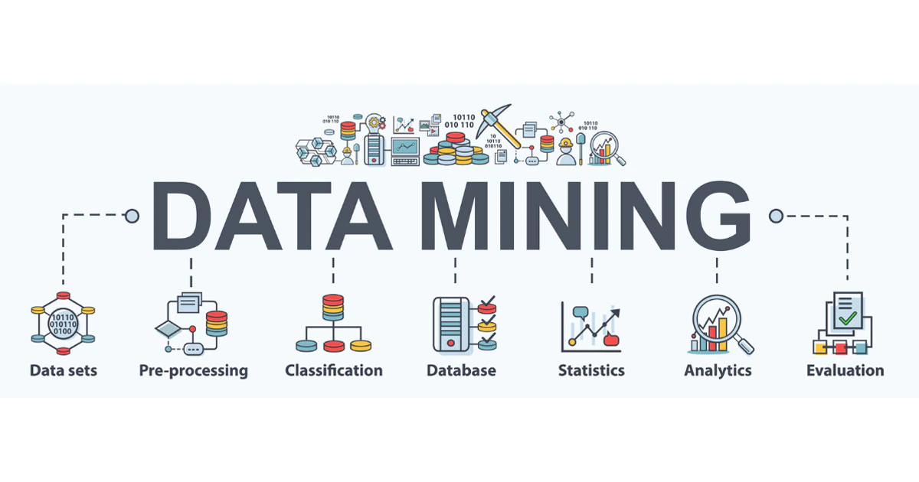
Data mining and Big Data Analytics

Slide 19
Data mining and Big Data Analytics
What is Big Data Analytics?
Big Data analytics is a process used to extract meaningful insights, such as hidden patterns, unknown correlations, market trends, and customer preferences. Big Data analytics provides various advantages—it can be used for better decision making, preventing fraudulent activities, among other things.
What is Big Data?
Big Data is a massive amount of data sets that cannot be stored, processed, or analyzed using traditional tools.
Today, there are millions of data sources that generate data at a very rapid rate. These data sources are present across the world. Some of the largest sources of data are social media platforms and networks. Let’s use Facebook as an example—it generates more than 500 terabytes of data every day. This data includes pictures, videos, messages, and more.
Data also exists in different formats, like structured data, semi-structured data, and unstructured data. For example, in a regular Excel sheet, data is classified as structured data—with a definite format. In contrast, emails fall under semi-structured, and your pictures and videos fall under unstructured data. All this data combined makes up Big Data.

Slide 20
Data mining and Big Data Analytics
Benefits and Advantages of Big Data Analytics
Risk Management : Use Case: Banco de Oro, a Phillippine banking company, uses Big Data analytics to identify fraudulent activities and discrepancies. The organization leverages it to narrow down a list of suspects or root causes of problems.
Product Development and Innovations: Use Case: Rolls-Royce, one of the largest manufacturers of jet engines for airlines and armed forces across the globe, uses Big Data analytics to analyze how efficient the engine designs are and if there is any need for improvements.
Quicker and Better Decision Making Within Organizations: Use Case: Starbucks uses Big Data analytics to make strategic decisions. For example, the company leverages it to decide if a particular location would be suitable for a new outlet or not. They will analyze several different factors, such as population, demographics, accessibility of the location, and more.
Improve Customer Experience: Use Case: Delta Air Lines uses Big Data analysis to improve customer experiences. They monitor tweets to find out their customers’ experience regarding their journeys, delays, and so on. The airline identifies negative tweets and does what’s necessary to remedy the situation. By publicly addressing these issues and offering solutions, it helps the airline build good customer relations.

Slide 21
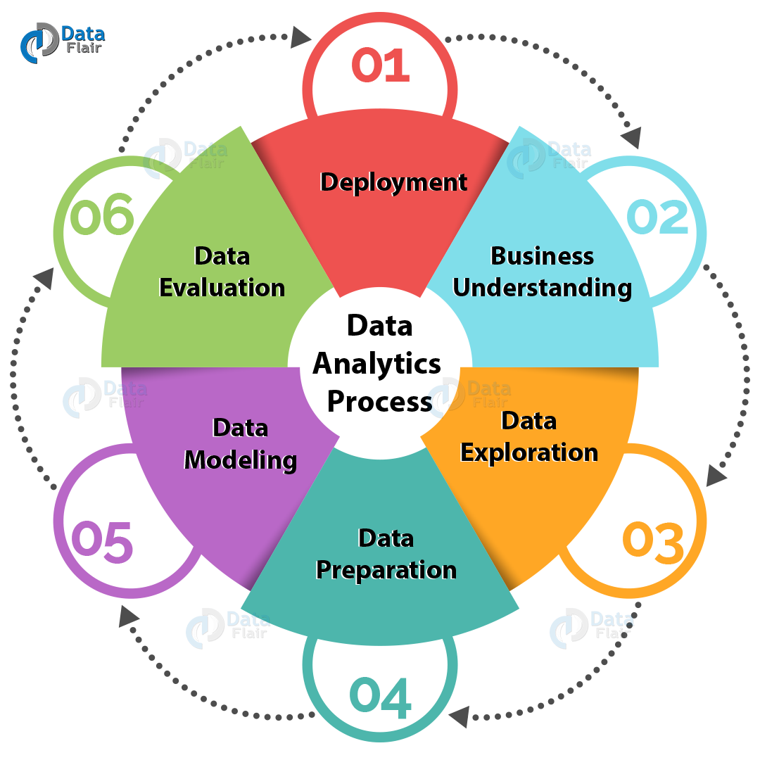
Data mining and Big Data Analytics

Slide 22
Cyber security and Public Key Infrastructure (PKI)
PKI definition
Public key infrastructure (PKI) is a catch-all term for everything used to establish and manage public key encryption, one of the most common forms of internet encryption. It is baked into every web browser in use today to secure traffic across the public internet, but organizations can also deploy it to secure their internal communications and access to connected devices.
The most crucial concept involved in PKI is, as its name implies, the public cryptographic keys that are at its core. These keys not only are part of the encryption process, but they help authenticate the identity of the communicating parties or devices.

Slide 23
Cyber security and Public Key Infrastructure (PKI)
What is PKI used for?
SSL may be the most widespread implementation of PKI, but it certainly isn't the only one. This Experts Exchange thread has a great list of real-world PKI applications, including:
Providing a recovery key for an encrypted hard drive
Securing internal communications with database servers
Signing documents
Securing local networks — PKI capacities are built into Microsoft's Active Directory, for instance, and can work with physical keycards that store digital certificates to ensure that users are who they say they are.
Secure messaging — The Signal protocol uses PKI, for instance
Email encryption
Securing access to internet of things (IoT) devices

Slide 24
https://www.investopedia.com/ask/answers/040915/what-difference-between-business-intelligence-and-competitive-intelligence.asp
https://www.ibm.com/cloud/learn/what-is-mobile-cloud-computing#:~:text=Mobile%20cloud%20computing%20uses%20cloud,revised%20quickly%20using%20cloud%20services.
https://blog.hootsuite.com/social-media-analytics/
https://www.netsuite.com/portal/resource/articles/data-warehouse/data-mining.shtml
https://www.csoonline.com/article/3400836/what-is-pki-and-how-it-secures-just-about-everything-online.html

